Slide 1
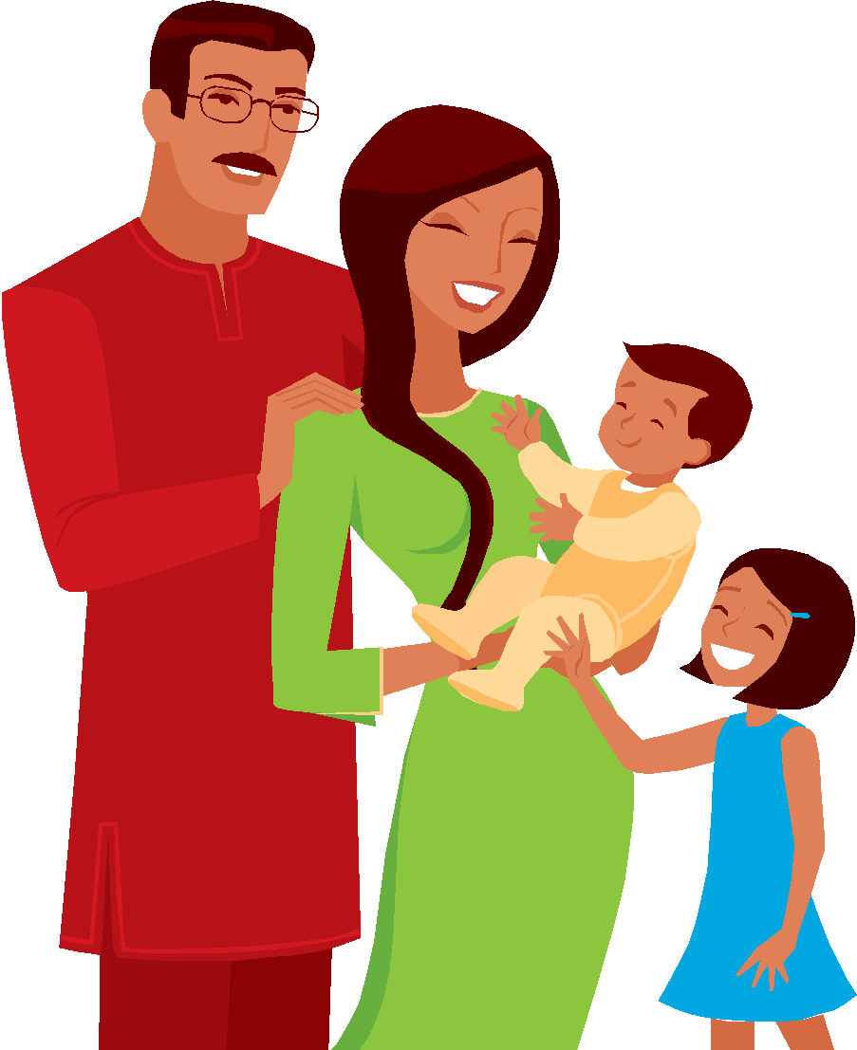



NOUNS AND PRONOUNS
ACT REVIEW

Slide 2
Every year my high school hosts international exchange students, those teenagers join our senior class.
NO CHANGE
students, he or she is invited to
students who
students they

Slide 3
THE BEST ANSWER IS……..
C
It appropriately uses the relative pronoun who to introduce the clause that modifies students.

Slide 4
THE RELATIVE PRONOUNS
The relative pronouns (who/whoever/which/that) relate groups of words to nouns or other pronouns (The student who studies hardest usually does the best.).

Slide 5
PERSONAL & POSSESSIVE PRONOUNS
Personal Pronouns Singular
1st person
I, my, mine, me
2nd person
you, your, yours
3rd person
he, she, it
his,her, hers,its
him,her,it

Slide 6
PERSONAL AND POSSESSIVE PRONOUNS PLURAL
Plural
1st person
We, our, ours, us
2nd person
you, your, yours
3rd person
they, their, theirs, them

Slide 7
ANOTHER EXAMPLE
You have to admire the honesty of a company who’s slogan is “Just About the Best.”
A. NO CHANGE
B. whose
C. that’s
D. that the

Slide 8
THE BEST ANSWER IS…..
B
It correctly uses the relative pronoun whose to introduce the clause that describes the company that the narrator admires. Who’s is a contraction…a shortened version of who is.

Slide 9
When you should use a noun….
For example, he says, the button that mutes the sound lets him cut them off in midsentence.
A. NO CHANGE
B. advertisers
C. it
D. its function

Slide 10
THE BEST ANSWER IS ………
B
Because advertisers is a specific noun that clearly communicates who Grandpa wants to be able to cut off in midsentence.
them-does not have a clear antecedent ( a noun that it stands for) ☹

Slide 11
NOT THE BEST ANSWER ☹
The pronoun it seems to refer back to the noun sound, but that doesn’t make sense.
The possessive pronoun its might refer back to the noun sound, but that doesn’t make sense either.

Slide 12
ANOTHER EXAMPLE
Also known as Tex-Mex or border music because of it’s having origins on both sides of the border.
A. NO CHANGE
B. ITS
C. IT’S
D. ITS’

Slide 13
THE BEST ANSWER IS……
B
Because is provides the correct form of the possessive pronoun its. The possessive pronoun its does not have an apostrophe.
EVER……
The other choices are contractions.

Slide 14
ANOTHER EXAMPLE
Teachers provide in-depth language understanding, and children are rewarded for improving his or her communication skills.
A. NO CHANGE
B. one’s
C. there
D. their

Slide 15
THE BEST ANSWER IS……
D
Because the possessive plural pronoun their agrees with the plural children.
His or Her are singular pronouns
One’s is possessive and singular
There is an adverb indicating place not a pronoun

Slide 16
ANOTHER EXAMPLE
Neither of the starting centers
is or are
able to travel to Dallas to play.

Slide 17
ANOTHER EXAMPLE
Someone dropped
his or her or their
drafting pencils on the floor.

Slide 18
THE LAST EXAMPLE
Each of the women in the room
is or are
hoping to be named Best Actress.

Slide 19
THE BEST ANSWERS ARE……
NEITHER OF THE STARTING CENTERS IS
SOMEONE DROPPED HIS OR HER PENCIL
EACH OF THE WOMEN IN THE ROOM IS

Slide 20
SINGLE INDEFINITE PRONOUNS
These pronouns take the singular form of the verb in most cases. Here are some of the common ones:
all, another, any, anybody/anyone, anything, each, everybody/everyone, everything, few, many, nobody, none, one, several, some, somebody/someone, either/neither

